Slide 1
Friction Modelling of a 6-DOF Robotic Arm Using Physics-Based & Data Driven Approaches
Submitted By:
Soumyadeep Dey
3rd year, Mechanical Engineering Department
National Institute of Technology Durgapur
CSIR-CMERI Internship

Slide 2
Introduction & Background
Introduction:
- Industrial robotic arm contains friction due to gearbox effects and elastic joints, high ratio harmonic drives.
- The accuracy of these systems depends on how strongly joint dynamics has been taken care of.
- Due to friction and internal loses the accuracy and positioning of the manipulator decreases.
Why Model Friction?
Friction from gearboxes and bearings reduces positioning accuracy and trajectory tracking.
While doing other project, though the friction is compensated by controllers, from data we found that some friction is still present.

Slide 3
Project Objectives:
Study friction characteristics of the 6-DOF robotic arm designed and developed by Svaya Robotics.
Compare classical physics-based models with machine learning (data-driven) models.
Experiment and literature reveals additional terms related to the change in phase of jts and mts data.

Slide 4
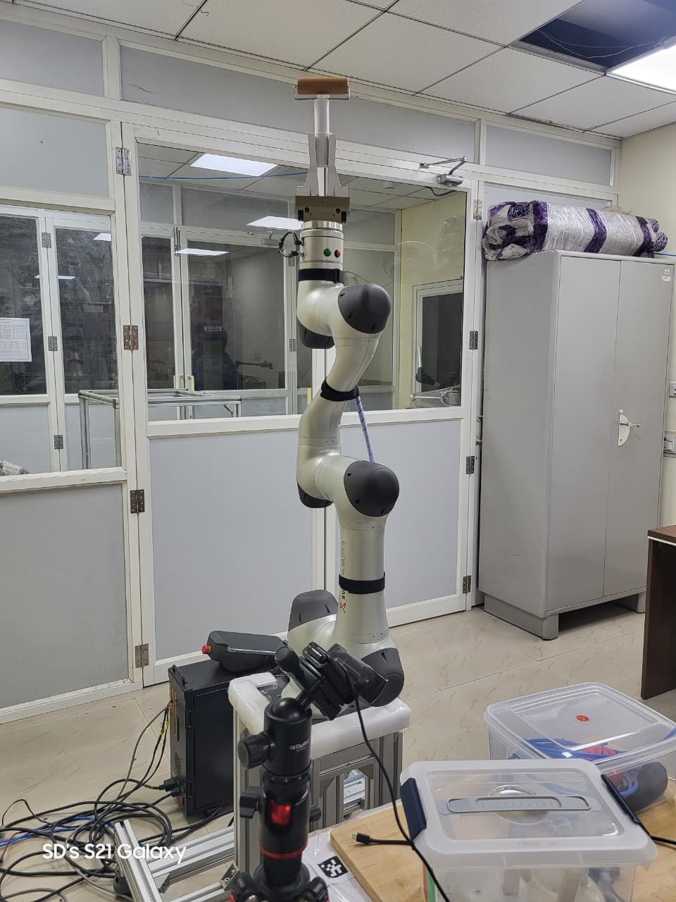
Fig. 1: The 6 DOF Robotic Arm.

Slide 5
Problem Statement
Identifying the Mathematical Relationship
Measured signals of the 4 joints: Motor torque (Tm), Joint torque (Tj), Velocity (v), Position (q).
And the resulting friction related torque losses.
Residual Torque Equation:
Tf = N × Tm − Tj (where Gearbox ratio N = 100)
Important Note:
Tf is a surrogate measure. It includes true friction + unmodeled dynamics, gearbox compliance, and transmission losses.

Slide 6
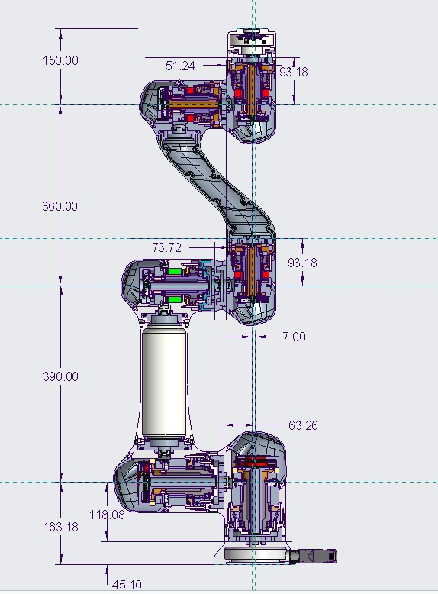
Fig. 2: Cross Sectional View of the Robotic Arm

Slide 7
Platform & Data Collection
The robotic arm developed by Svaya Robotics has
6 revolute joints with harmonic drive transmission.
Joint position encoders, velocity estimation, joint and motor torque sensing devices, as shown in fig 2.
Data Acquisition Parameters:
Data is collected with 5ms response time (200 Hz).
Forward-reverse kinematics were used to capture velocity reversals.

Slide 8
Literature Review & Research Gap
After studying the papers [1] [2] [3], I got the idea of different friction models, both static and dynamics, like Coloumb, Viscous, Stribeck, Lugre, Dahl, General Maxwell Slip, etc. and how losses occur like stick-slip condition, hysteresis losses, velocity reversals, etc.
In paper [4], they have run matlab simulation of the friction modelling by PINN and parameter estimation (state variable of Lugre friction model) on a pendulum on a box, and equations of motion were used in the loss function of PINN and validated the output while attaching a spring on the body.
In paper [5], they have performed physics informed learning of a humanoid robot (ergoCub) while applying only load dynamics for high-ratio harmonic drives. They have not stated any relation against elastic joints or how can we model them.

Slide 9
In summary of the above research papers:
Existing Approaches:
Static Models (Coulomb-Viscous): Fast but miss complex dynamics.
Dynamic Models (LuGre): High realism but parameter identification is highly complex.
Machine Learning: High predictive accuracy but lacks physical interpretability.
PINN: Physics equations with ML, improve generalization, reduce overfitting, but highly computational
The Research Gap:
Most current research uses MATLAB simulation and ignores real-world environmental dynamics.
This project evaluates classical vs. ML models using actual experimental data from a real physical joint.

Slide 10
Physics-Based Friction Modelling
1. Coulomb + Viscous Model
Tf(v) = Tc tanh(v/Vs) + B_v × v
Uses tanh() instead of sign() to avoid optimization issues at zero velocity.
Limitations Observed:
Structured residuals indicate unmodelled nonlinear dynamics (like elasticity and compliance).

Slide 11
Physics-Based Models: Results
When data split is sequential and it is trained on repetitive data model achieved R² score of
Joint 1 = 0.9711
Joint 2 = -0.3450
Joint 3 = 0.7489
Joint 5 = 0.9226
ML models cannot readily learn the non linear parameters without proper considerations.
It is giving inflated R² score, model is not training itself but it is learning the output.

Slide 12
Physics-Based Models: Results
When data split is random using train_test_split and it is trained on unique data points model achieved R² score of
Joint 1 = 0.9782
Joint 2 = 0.7705
Joint 3 = 0.7262
Joint 5 = 0.9326
According to the plots, it is giving significantly valid frictional torque.
It is giving somewhat correct R² score, model is recognizing the patterns.

Slide 13
Data-Driven Modelling (Neural Network)
Black-Box Neural Network Approach
3 approaches were used
Inputs: Joint Position (q) and Velocity (v).
Outputs: Frictional torque.
Why?
Learns friction behavior directly from robot state variables without rigid physical assumptions.
Metrices used to evaluate the model are RMSE, MAE and R2 score.

Slide 14
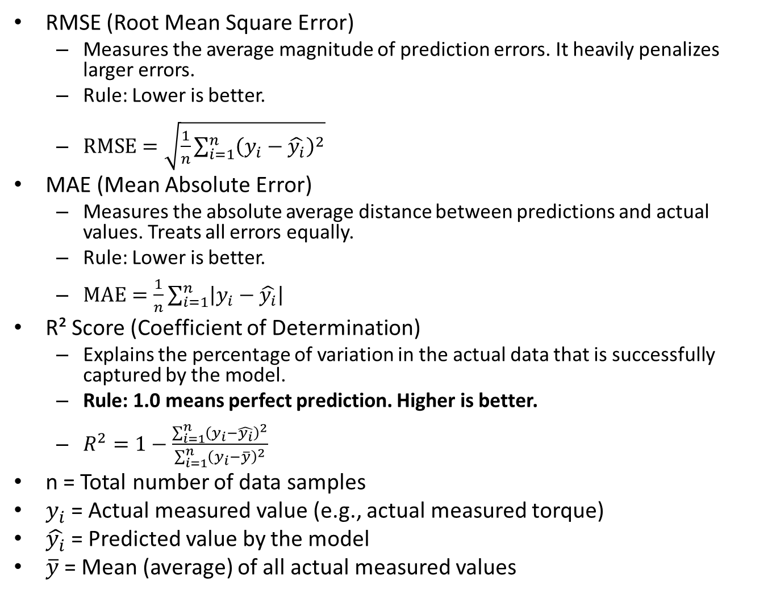
RMSE (Root Mean Square Error)
Measures the average magnitude of prediction errors. It heavily penalizes larger errors.
Rule: Lower is better.
$\text{RMSE}=\sqrt{\frac{1}{n}\sum_{i=1}^{n}{{\left(y_{i}−\hat{y_{i}}\right)}^{2}}}$
MAE (Mean Absolute Error)
Measures the absolute average distance between predictions and actual values. Treats all errors equally.
Rule: Lower is better.
$\text{MAE}=\frac{1}{n}\sum_{i=1}^{n}{\left|y_{i}−\hat{y_{i}}\right|}$
R² Score (Coefficient of Determination)
Explains the percentage of variation in the actual data that is successfully captured by the model.
Rule: 1.0 means perfect prediction. Higher is better.
$R^{2}=1−\frac{\sum_{i=1}^{n}{{\left(y_{i}−\hat{y_{i}}\right)}^{2}}}{\sum_{i=1}^{n}{{\left(y_{i}−\overline{y}\right)}^{2}}}$
n = Total number of data samples
$y_{i}$= Actual measured value (e.g., actual measured torque)
$\hat{y_{i}}$= Predicted value by the model
$\overline{y}$= Mean (average) of all actual measured values

Slide 15
Data split is sequential and model is trained on repetitive data, and R² score of
Joint 1 = 0.9965
Joint 2 = 0.7488
Joint 3 = 0.9920
Joint 5 = 0.9926
It is giving inflated R² score
Data split is train_test_split randomly and model is trained unique data, and R² score of
Joint 1 = 0.9966
Joint 2 = 0.8773
Joint 3 = 0.9822
Joint 5 = 0.9880
It is giving inflated R² score
Data split is train_test_split randomly and model is trained on some velocitites and tested on unseen velocities, and R² score of
Joint 1 = 0.9961
Joint 2 = 0.8784
Joint 3 = 0.9800
Joint 5 = 0.9906
It is giving somewhat correct R² score

Slide 16
Comparative Analysis
Joint | Model Type | R² Score
Joint 1 | Coulomb + Viscous (Physics) | 0.9782
 | Black-Box Neural Network | 0.9961
Joint 2 | Coulomb + Viscous (Physics) | 0.7705
 | Black-Box Neural Network | 0.8784
Joint 3 | Coulomb + Viscous (Physics) | 0.7262
 | Black-Box Neural Network | 0.9800
Joint 5 | Coulomb + Viscous (Physics) | 0.9326
 | Black-Box Neural Network | 0.9906

Slide 17
Conclusions
Friction is the dominant source of torque loss in the Svaya robot.
Phase difference show spring-mass and damper system dynamics originating from harmonic drive elasticity.
Data-driven methods show strong potential for future real-world torque compensation.

Slide 18
Future Work
Implementation of the LuGre dynamic friction model.
Exploration of Physics-Informed Neural Networks (PINNs) to bridge the gap between ML accuracy and physics interpretability.
Modelling multi-joint coupled dynamics.

Slide 19
References
[1] Olsson, H., Åström, K. J., Canudas de Wit, C., Gäfvert, M., & Lischinsky, P. (1997). 'Friction Models and Friction Compensation.'
[2] Rizos, D. D., & Fassois, S. D. (2005). 'Friction identification based upon the extended Maxwell slip model.'
[3] van Geffen, V. (2009). 'A Study of Friction Models and Friction Compensation.’
[4] Sorrentino, S., et al. (2024). 'PINN-based friction modelling framework for harmonic-drive robotic joints.’
[5] Ozmen, Asutay, Joao P. Hespanha, and Katie Byl. "Learning Transferable Friction Models and LuGre Identification via Physics Informed Neural Networks." arXiv preprint arXiv:2504.12441 (2025).
[6] Svaya Robotics User Manual, 2023.

Slide 20
Thank You

